Slide 1
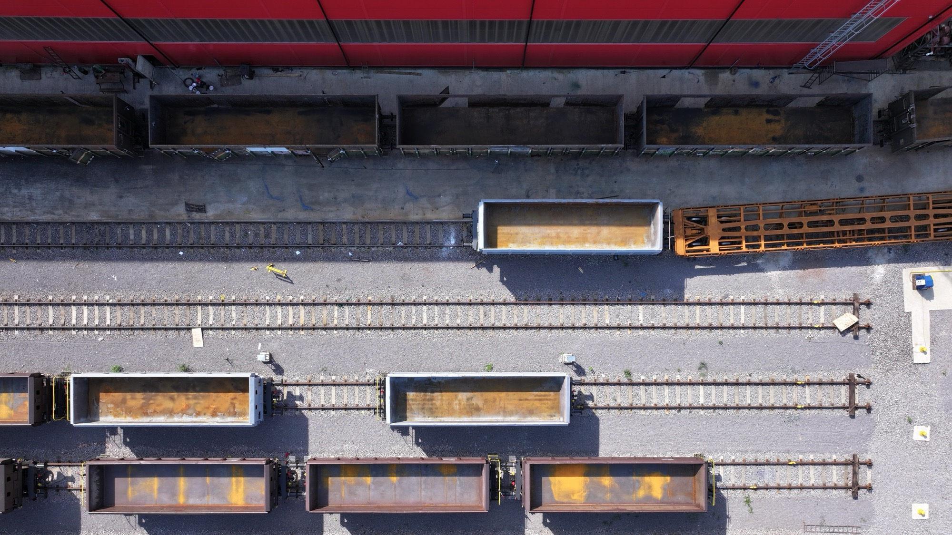
LOKO TRANS Slovakia

Slide 2
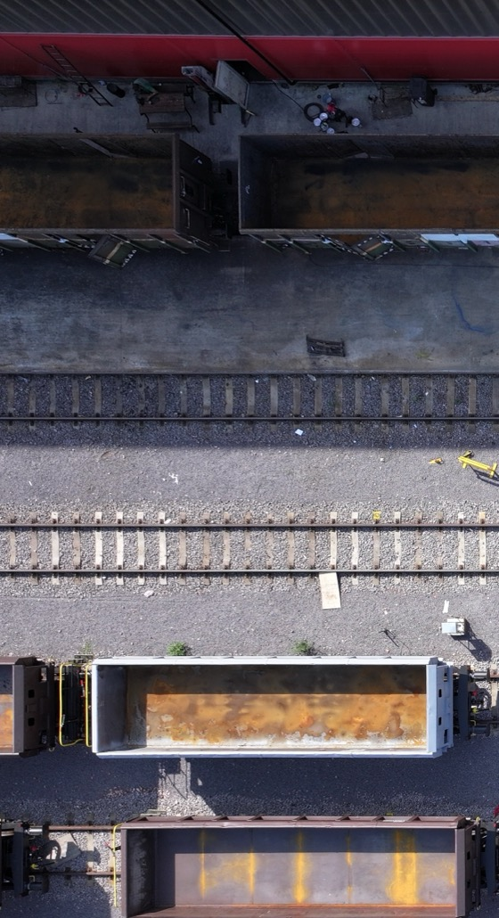
Production
On-site service
Non-destructive
testing
Storage
Revisions

Slide 3
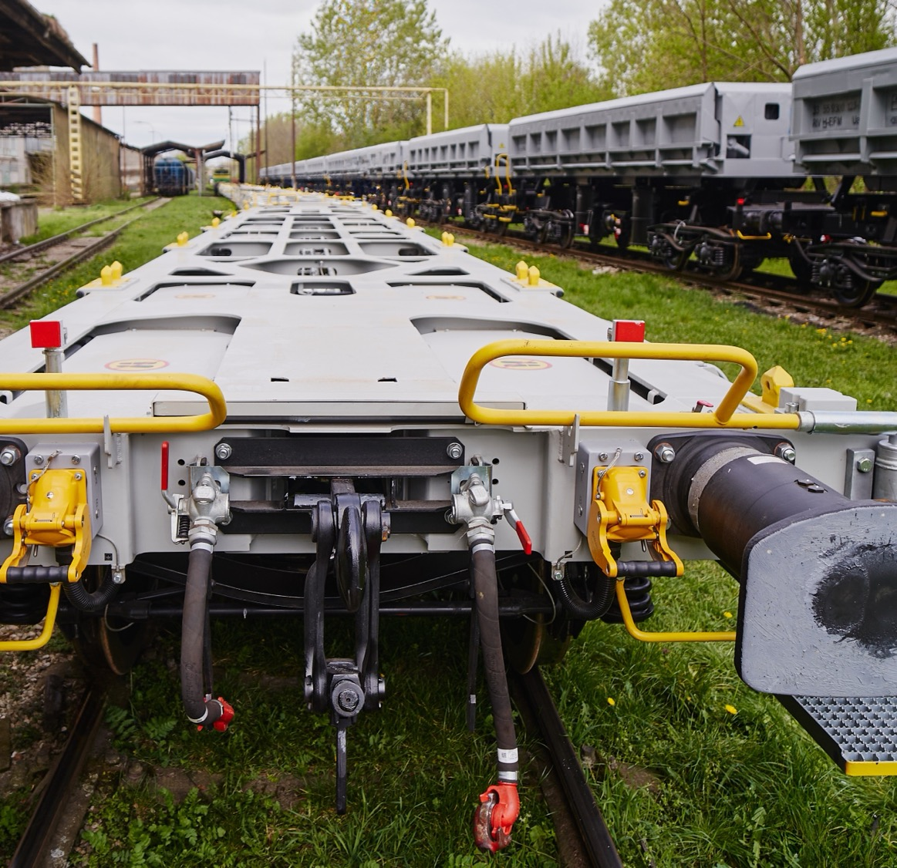
Production of
freight wagons
In collaboration with our Swiss partners, we initiated the development of three types of freight container wagons – bogie wagons Sgns(s) 60’, Sgmmns(s) 40’, and 2-axle wagons Lgns 40’. During 2023 and 2024, prototype production and testing of these wagons were successfully completed, and we obtained TSI certificates for their production. The approval process with ERA is expected to be finalized by the end of 2024.

Slide 4
Lgns 40‘ 2024
Sgmmns (s) 40´ 2024
Sgns (s) 60´ 2024

Slide 5
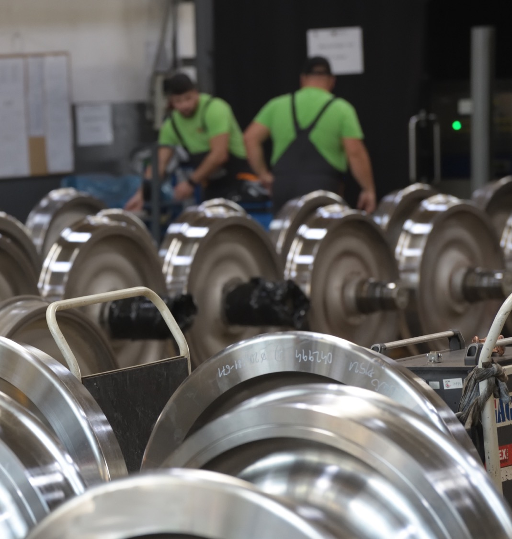
Production of
wheelsets
The approved production process focuses on the manufacturing of new wheelsets for freight wagons using new components.
The components used are provided with complete technical documentation and are supplied by approved manufacturers. With modern technical equipment and experienced personnel, we ensure a production process at our facility that achieves the required quality and customer satisfaction.

Slide 6
Approved wheelset design types: LTS 25t and LTS 23.5t/22.5t

Slide 7
On-site service
for rail vehicles
On-site services
Replacement of wheelsets and bogies with wagon lifting on-site
Replacement of traction and buffer gear
Replacement of brake equipment (brake distributors, relay valves, load sensors, adjusters, etc.)
Replacement of brake shoes
Replacement and repair of steps, handrails, and other safety components
Replacement of drain and safety valves on tank wagons
Repair of wagon superstructures through welding and straightening
Brake testing according to UIC 543-1
Repair of damaged markings and paintwork
Additional lubrication of structural components of freight wagons
Cleaning wagons of transported substrate
Safety inspections
Inspection of freight wagons according to the AVV contract
Inspection and repair of wagons based on the client’s individual requirements
Issuance of documentation for individual repairs
Provision of spare parts and assemblies

Slide 8
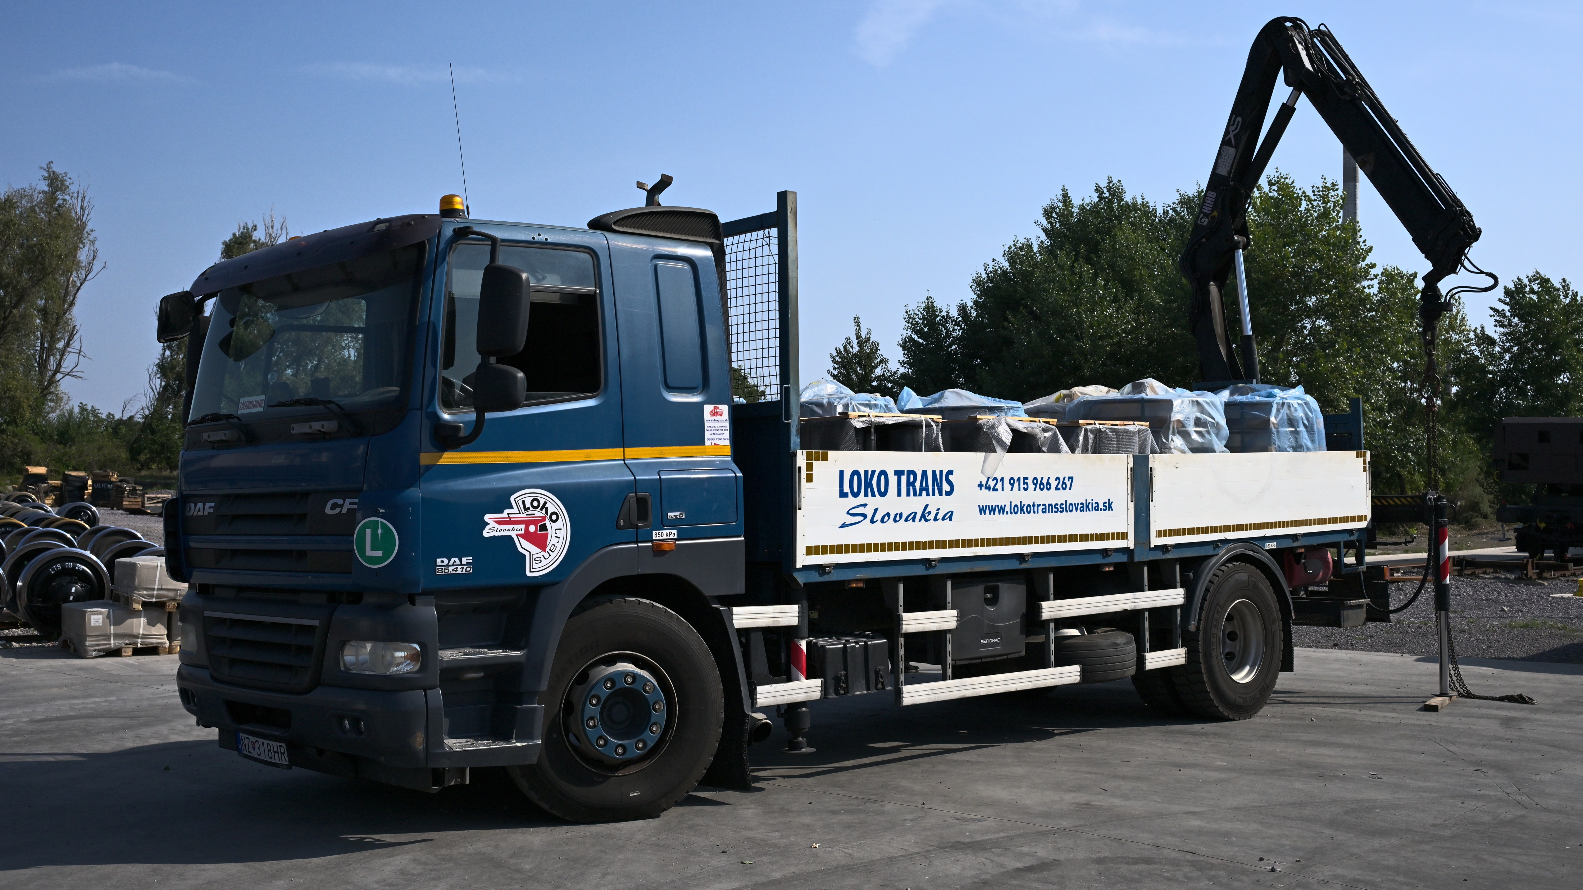
Our equipment
4 fully equipped service vehicles
Truck with a hydraulic arm capable of transporting six wheelsets
Coupling and lifting device Hegenscheidt for wagons and locomotives
Stationary brake test equipment PDR5

Slide 9
As part of our wheelset service, we offer an all-in-one service:
Storage
Repair of wheelsets according to SÚNV, KVs5B-2010, and VPI regulations
Transportation of wheelsets to the replacement site using a truck with a hydraulic arm
Wheelset replacement using the Hegensheidt lifting device

Slide 10
Non-destructive testing
Methods
Ultrasonic Testing (UT)
Utilizes ultrasonic waves to detect internal material anomalies.
Magnetic Particle Testing (MT)
Applies a magnetic field to the material – defects alter the magnetic field, allowing their identification.
Liquid Penetrant Testing (PT)
Uses a penetrant liquid that seeps into surface cracks, making defects visible after applying a developer.
Visual Testing (VT)
A fundamental method employing visual inspection to identify surface irregularities.
NDT is a technique used to assess the integrity of railway components and infrastructure without damaging the tested material.
These methods ensure the safety and reliability of railway systems. At LOKO TRANS Slovakia, we consider NDT a fundamental pillar of operational quality and safety.

Slide 11
Technical equipment
MZZD-2500-R
For the inspection of complete wheelsets, enabling testing with or without monoblocks
MAS 1500 HD Plus
Designed for inspecting smaller components up to a length of 1500 mm
Ultrasounds OLYMPUS
Specialized technical equipment for UT (Ultrasonic Testing) inspections

Slide 12
Certifications and Authorizations
Technicians are certified according to EN ISO 9712 and UIC 960, accredited by COO NSD Bratislava and České dráhy, a.s.
The company holds authorization from the Transport Authority in Bratislava and HDS KV Prague
Successfully completed VPI certification for the NDT RAILWAY certification scheme by W.S. CERT

Slide 13
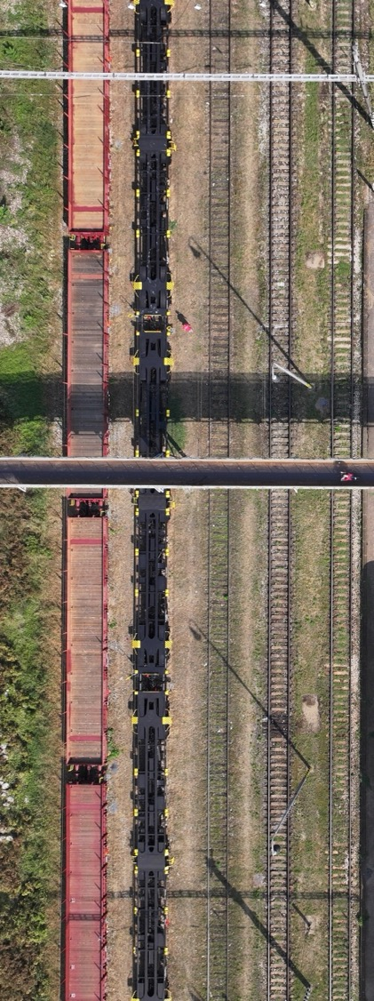
Wagon storage
and routine wagon repairs
The company LOKO TRANS Slovakia, s.r.o. operates and utilizes the SPaP siding in Komárno, where we provide tracks for both short-term and long-term wagon storage for our business partners. The siding includes tracks that we also use for performing routine wagon repairs, exclusively carried out by the
mobile on-site service of LOKO TRANS Slovakia, s.r.o. On the siding, we provide transportation with our own locomotive, offering services such as shunting, positioning, and removing wagons between the SPaP siding and the Komárno railway station, as well as handling regular train operations.

Slide 14
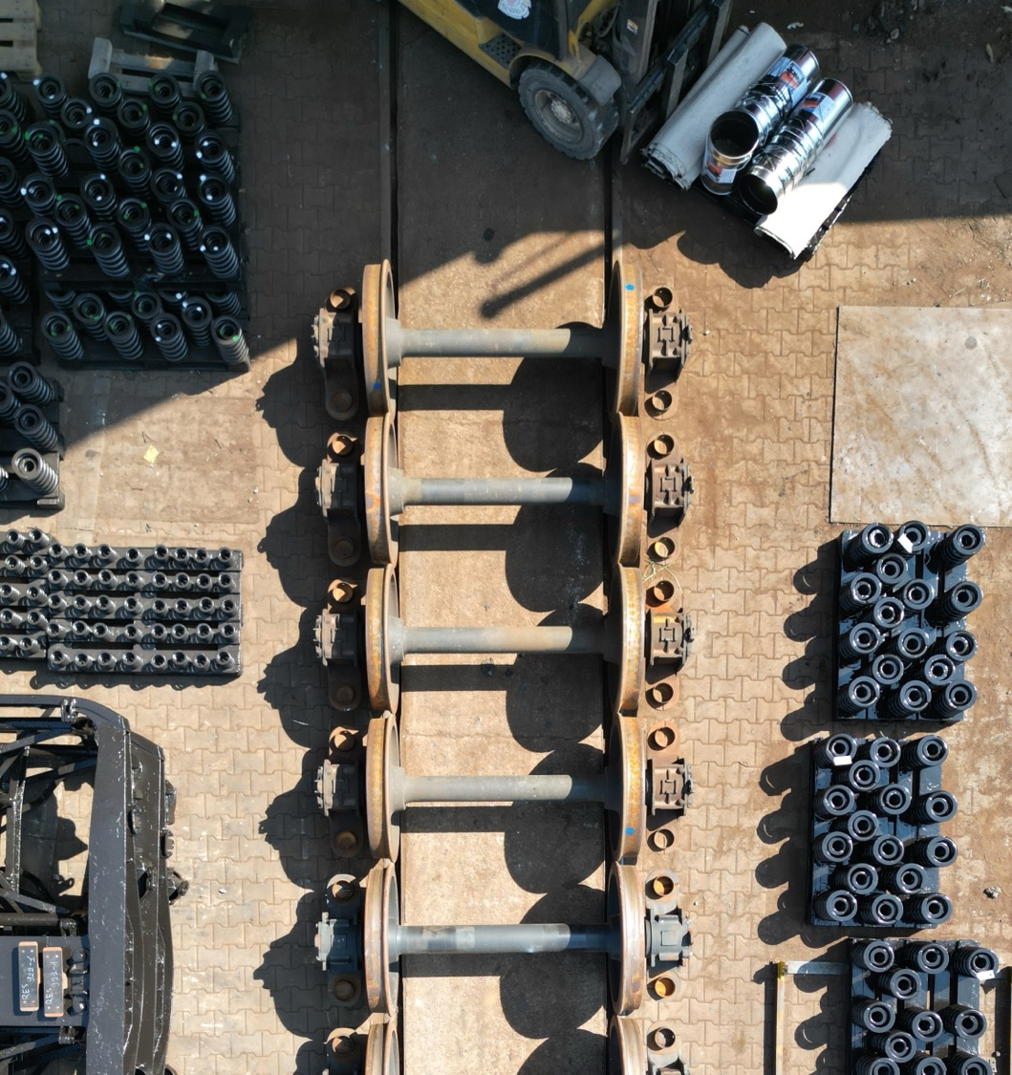
Wheelset revisions
The operational production process focuses on assessing the condition, conducting revision inspections, and repairing freight wagons and wheelsets to meet the requirements of external customers. With modern technical equipment, skilled personnel, and years of experience, we strive to achieve quality and customer satisfaction.
The repair process for freight wagons and wheelsets is tailored to the customer’s requirements, and maintenance is performed according to the requested regulations.

Slide 15
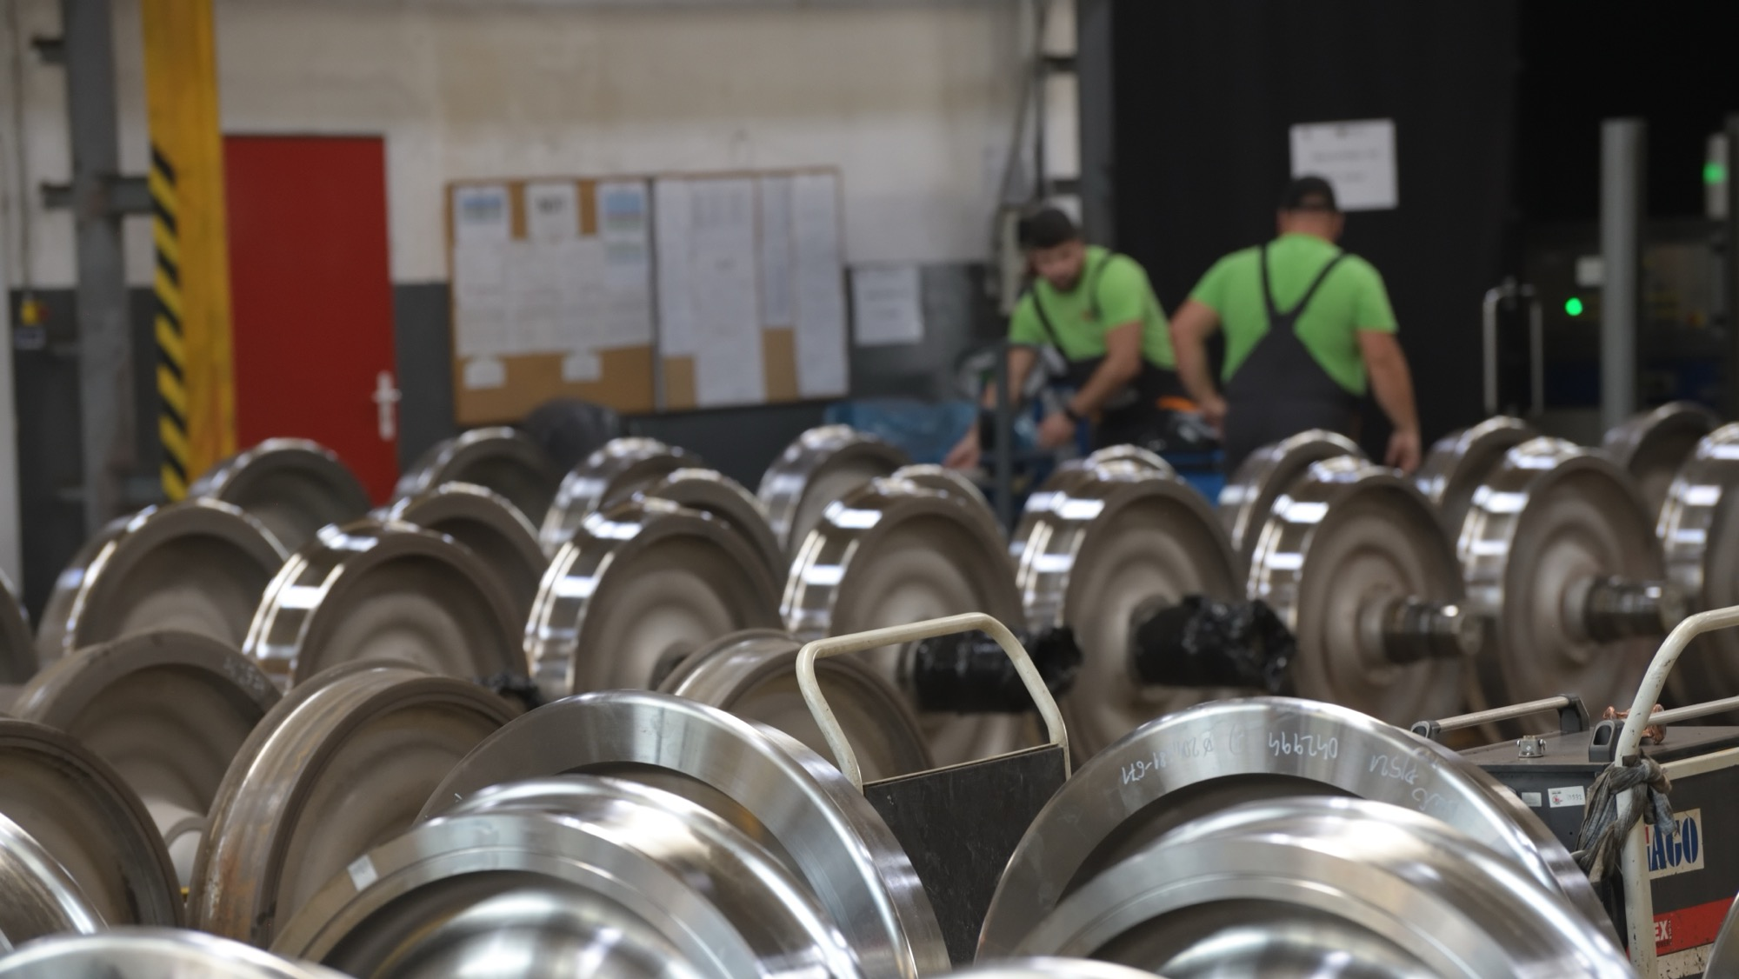
The maintenance levels are carried out according to regulations and the defined scope:
Regulation Maintenance Level
KVs5-B-2010 DO, DO1, D1, D2, D3, D4, D5
SÚNV version 4.1 ZSSKC revízia, revízia +
VPI-EMG 04 IS0, IL, IS2, IS3
VPI-EMG 01 IS0, IL, IS2, IS3

Slide 16
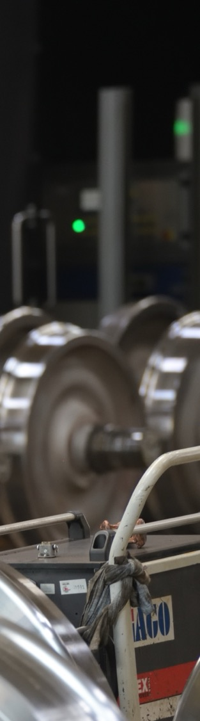
To ensure and achieve high quality in our operations, we utilize modern technical equipment, CNC machining tools, devices, and measuring instruments
VB 02 400t Press
Dismantling of wheelsets
TTK-SAF Blasting Equipment
Cleaning and removal of impurities from wheelsets
VERTA Painting and Drying Booth
Surface treatment of wheelsets (painting and drying)
MZZD-2500-R NDT Equipment
For the inspection of complete wheelsets, enabling testing with or without monoblocks
Equipment for Assembly and Disassembly Installation and removal of bearing chambers, bearings, and bearing rings.
Honor BNC 40120 Lathe
Machining of axles (repair of bearing journal, monoblock seat, support ring seat, and shaft)
VL 100C Lathe
Machining of wheel hubs (monoblocks)
RAFAMET UBF 112N Lathe
Machining of wheelsets (monoblocks)

Slide 17
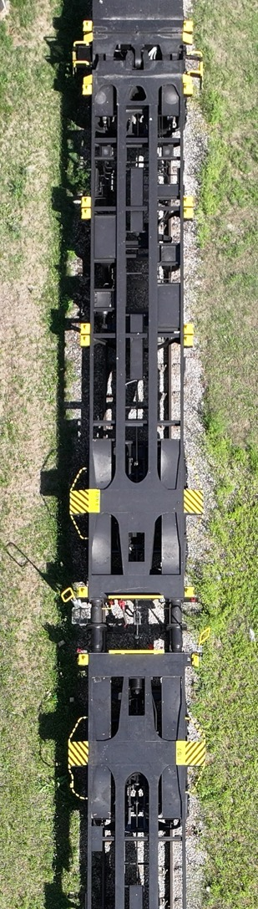
Freight wagon
revisions
Reception and incoming inspection
Each wagon arriving at our facility is thoroughly registered and assigned to the maintenance tracking system.
Our technicians perform an initial inspection of the wagon to identify any visible damage or wear. This inspection includes checking the wheelsets, axles, bogies, wagon superstructures, and brake components.
Disassembly and detailed diagnostics
The wagon is disassembled into individual components, enabling a detailed inspection of each part. We utilize advanced diagnostic tools and methods to assess the condition of every component. This includes non-destructive testing, ultrasonic inspections, visual checks, and other specialized techniques.

Slide 18
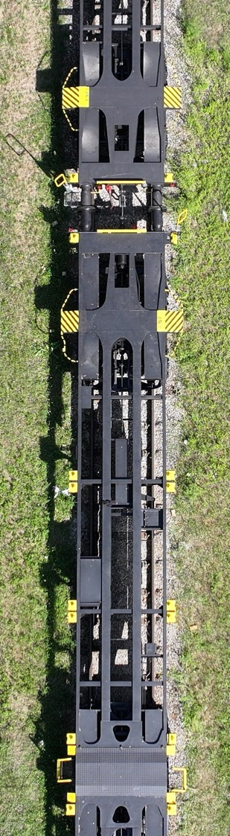
Repair and replacement of components
After identifying damaged or worn parts, our experts perform the necessary repairs. This may include welding, grinding, reconditioning, and other specialized repairs, such as fixing couplers, brake components, weighing springs and leaf springs, or repairing bogies. If some parts cannot be repaired, they are replaced with new ones according to the manufacturer’s specifications.
Assembly and finalization
After repairing and replacing components, all parts are reassembled. Our technicians ensure that all parts are properly installed, thoroughly inspected, and function flawlessly. The wagon undergoes surface treatment according to the technological procedure and is then fully assembled and sent for final inspection to ensure all repairs meet the highest standards. This includes checking the functionality of brakes, suspension, and other critical systems.

Slide 19
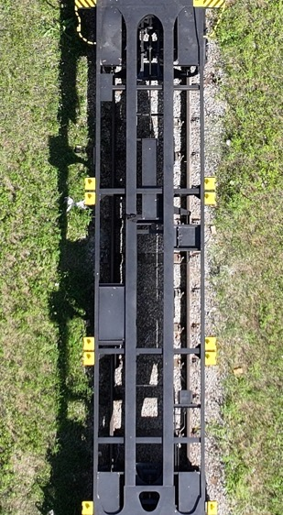
Final Review and Submission
Our technicians conduct a final inspection, which includes checking all completed work and verifying that all components function correctly. We prepare detailed documentation of all repairs and modifications, which is provided to the customer for their records.
After successfully completing all inspections, the wagon is ready for handover to the customer. We inform the customer about all the work performed and provide recommendations for future maintenance.

Slide 20
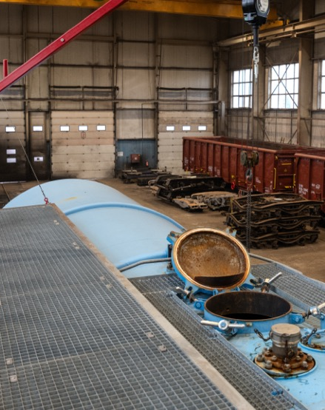
Maintenance and Repair
of Tank Wagons
LOKO TRANS Slovakia specializes in the maintenance and repair of tank freight wagons used for transporting mineral oils and their derivatives. Thanks to modern technologies, a skilled team, and certified processes, we ensure the highest quality, safety, and reliability of your wagons.
Repairs and restoration of inscriptions on tank wagons.
Provision of spare parts and materials necessary for repairs.
Periodic inspections and pressure tests in compliance with applicable regulations.

Slide 21
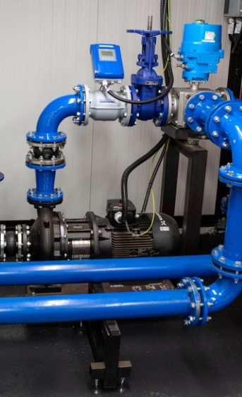
Our facility is equipped with modern technologies to ensure high quality and efficiency in repairs.
Transfer Unit with a capacity of 110 m³/h and multi-level protection
The current volume of the testing medium is 95 m³, with plans to expand to 200 m³ to increase repair capacity.
Vacuum-Pressure Testing Station
Equipped with a control panel for measuring vacuum and pressure values before and after the repair of fittings and valves. The system provides automatic evaluation and generates electronic reports.
Compressed air source with a maximum pressure of 7 bar for performing leak tests.
Control Software
• Monitoring of current data
• Status display using light signals
• Adjustment of the volume of transferred media
• Remote two-hand control with fall protection

Slide 22
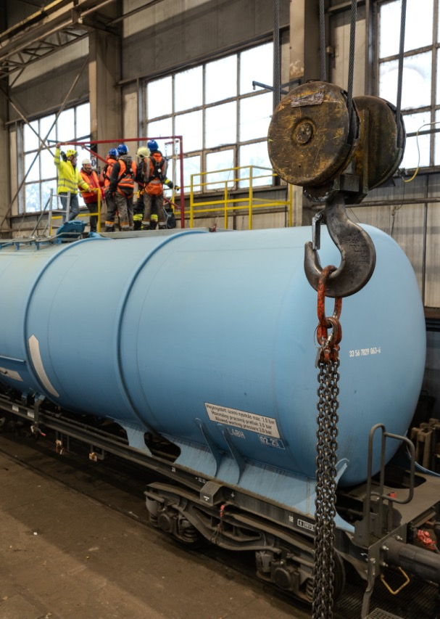
We perform maintenance and repairs based on valid authorizations and certifications.
Certificate of Conformity for ECM F4 Maintenance Functions – also includes specialized wagons designed for the transport of hazardous goods.
Authorization issued by the Transport Authority of the Slovak Republic for the assembly, repair, maintenance, reconstruction, inspection, and testing of specified pressure technical equipment.
Certificate of Conformity according to EN 14025:2018 + AC:2020 and RID:2023, Chapter 6.8.2.1.23 for welding pressure vessels (black steel only) within the scope of WPQR.
VPI Certificate for the maintenance of tank wagons used for transporting mineral oils and their derivatives.

Slide 23
Authorization
Authorization to perform repairs, reconstructions, revisions, and tests on designated lifting technical equipment
for installation, repairs, maintenance, reconstructions, revisions, and testing of designated pressure technical equipment
Certificates
ISO 9001:2016
Declaration of Authorized Certification Body No. 705 in the field of welding process certification for the ČD Group (ČD Regulation V95/5)
Certificate of Maintenance Functions
ISO 45001:2019
Certificate of Professional Competence
Production, reconstruction, and repairs of railway vehicles for ZSSK CARGO
DIN EN 15085-2 CL1 - Šurany
EC Type Examination Certificate for
Wheelset LTS 25t
Certificate of Entity in Charge of
Maintenance (ECM)
Authorization for welding railway
vehicles
EC Type Examination Certificate for
Wheelset LTS 23.5t
Certificate of Supplier Qualification
Authorization for non-destructive
testing of railway vehicles
Repairs of Nbo, Nbt, repairs of mechanical damage, revision repairs (Rev), and technical inspections of Eas-11., 52., 53., 54. freight wagon series owned by the ČD Group, in compliance with the internal directive of ČD Cargo, a.s. KVs 5-B-2010 and approved technological procedures.
EC Type Examination Certificate for Wheelset LTS 23.5t / 22.5t
Authorization for defectoscopic testing
EC Type Examination Certificate - Sgns
VPI Certificate
ISO 14001:2016
STN EN ISO 3834 part 2
Authorization for performing technical
inspections of railway vehicles
Steel welded structures, railway vehicles
NDT Certificate - VPI

